Slide 1
MCH Nurse Student Orientation
Learning@QEC Department
Email: learning@qec.org.au

Slide 2
Our Acknowledgement of Country
QEC acknowledges all Aboriginal and Torres Strait Islander peoples as traditional owners of the lands on which we walk, live and raise our children. We pay our respects to traditional owners past, present and future. We acknowledge the importance of children being raised with connections to culture, community and family.

Slide 3
QEC Values

Slide 4
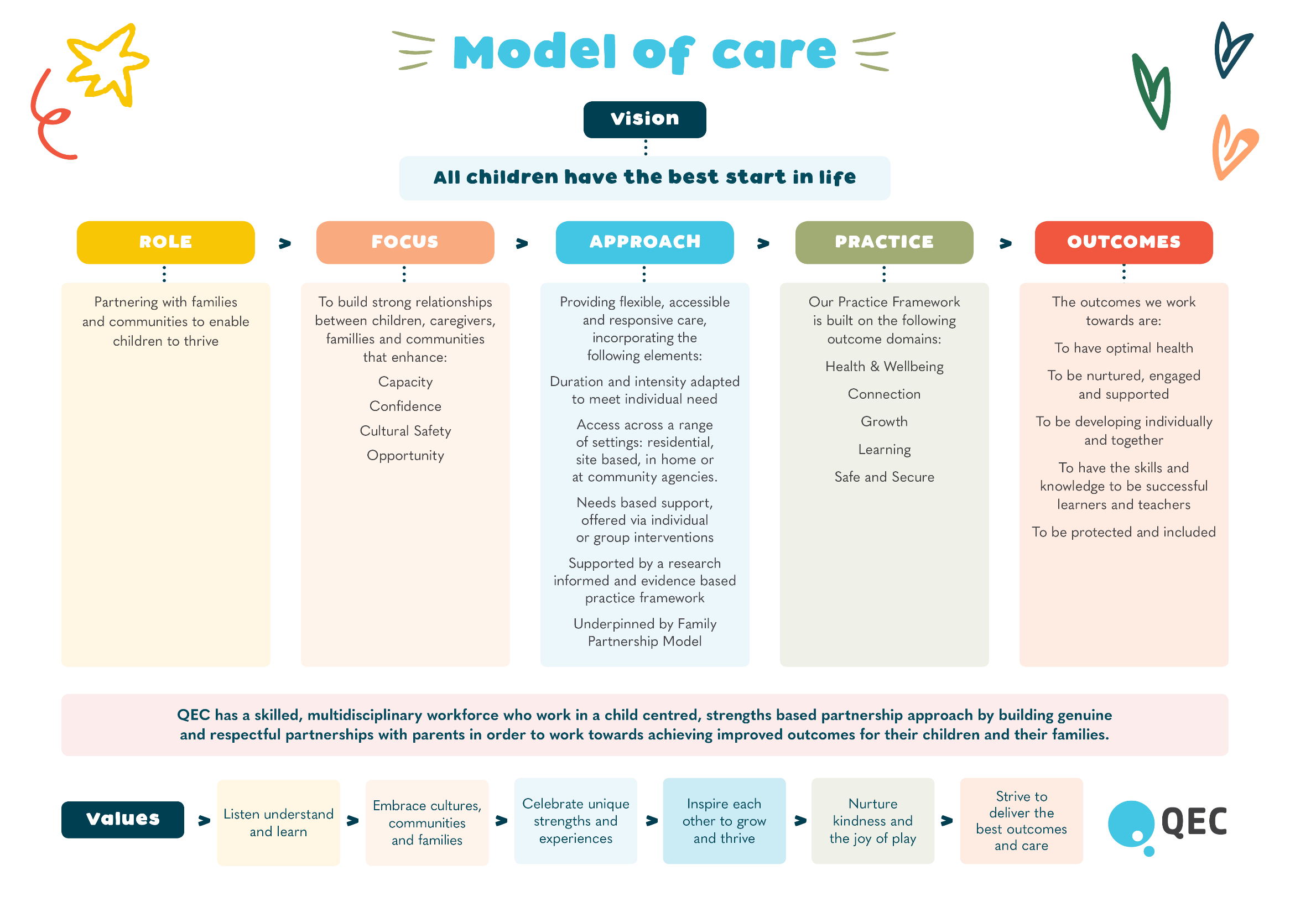

Slide 5
QEC Organisational Chart
Board of Management
Chief Executive Officer
Sue White
Director Nursing & Clinical Operations
Elaine Grant
Director of Clinical Innovation and Development
Helen Cunningham
Director of Finance and Business Services
Owain Hughes
Director Corporate Services
Casey Hepburn
Approximately 150 clinical and non-clinical employees.
MCH Nurses, Registered Midwives, Registered Nurses, Enrolled nurses, Social Workers, Early Childhood Educators, Psychologists, Art Therapist, Medical Practitioner, Administrators, Educators, Information Technology Specialists, Commercial & Finance, People & Culture, Infrastructure and Volunteers

Slide 6
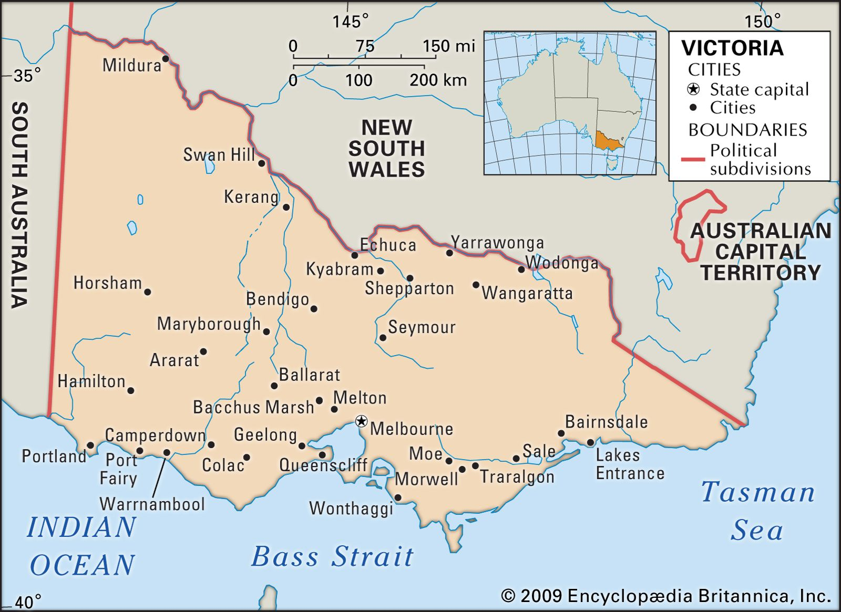
QEC sites
1. Noble Park
Assessment and Intake, Residential, Telehealth, DayStay, PlaySteps & Residential Parenting Assessment and Skills Development (PASD)
2. Dandenong South
Home based Parenting Assessment and Skills Development (PASD), Stronger Families & Parenting Plus
Family Preservation and Reunification Response (FPRR)
3. Preston
Home based Parenting Assessment and Skills Development (PASD) & Stronger Families
4. Morwell
Home based Parenting Assessment and Skills Development (PASD), Family Preservation and Reunification Response (FPRR), Stronger Families, Individual Child & Family Support 10, 40, 110 & 200 hours
5. Bairnsdale
Home based Parenting Assessment and Skills Development (PASD)
6. Wodonga
Home based Parenting Assessment and Skills Development (PASD) & Individual Child and Family Support programs

Slide 7
QEC Residential Programs – Noble Park
Assessment & Intake
Receive both self-referrals and professional referrals
Determine priority and allocation to program
Day Stay
1 Day program on site (telehealth optional available)
Residential
5 days onsite program
5 days Telehealth program
Residential PASD
Programs include: phone advice, Day Stay, Residential 3-5 days onsite, Telehealth 5 days, home visiting & PlaySteps
10 days onsite program
Referrals only from DFFH – Child Protection

Slide 8
QEC PlaySteps and Home Based Programs
PlaySteps
8 week program
Focused on enhancing parent/caregiver – child relationship
Parenting Plus
Home visiting program
Early intervention program
Home based PASDS
Home based program 10-12 weeks
Consultations in the home and via telehealth
Consultations in the home and via telehealth
Referrals only from DFFH – Child Protection

Slide 9
QEC Home Based Programs - continued
Stronger Families
12 month program (Dandenong, Preston & Morwell)
Individual Child & Family Support (ICFS)
Morwell & Wodonga
Intensive home visiting support program
Family Preservation and Reunification Response
Intensive Case Management program (Dandenong, Morwell)
Families experiencing significant vulnerability
Consultations either in the home and via telehealth
Consultations either in the home and via telehealth
Provide parenting education and support working with a care team
Consultations either in the home and via telehealth
Families experiencing vulnerability

Slide 10
QEC Early Parenting Services
In the 2022/2023 period:
1335 requests for QEC EPC services
983 admissions to residential programs
69% of referrals received were self-referrals
Family/Primary carer presenting needs are:
Sleep & settling
Bonding and attachment difficulties
Mental Health
Child behaviour
Most professional referrals are from MCH nurses

Slide 11
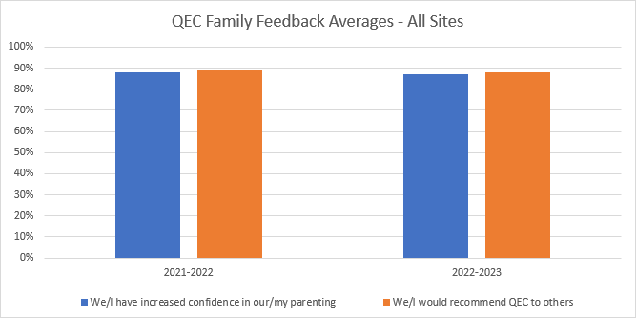
QEC Family Feedback From July 2021 to June 2023

Slide 12
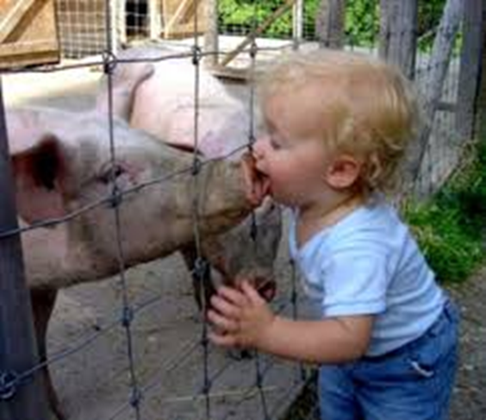
Infection Prevention and Control
QEC employees must follow:
Standard Precautions
Hand Hygiene
Use of personal protective equipment (PPE)
Routine environmental cleaning
Waste management
Cleaning and disposal of equipment
QEC immunisation requirements
Universal Precautions
Assume that all blood and bodily substances are considered potentially infectious at all times, regardless of the perceived status of the individual.

Slide 13
QEC’s COVID Safe Plan
Daily attestations (via an online system ‘Sine Pro’)
Hand hygiene and Infection Control
Use of masks – as required
Cough etiquette and respiratory hygiene
Increased environmental cleaning
Staying home and seeking testing if unwell
Ongoing education and auditing
Prioritising the health and wellbeing of our employees and the families we care for.

Slide 14
QEC Conduct and Positive Workplace Behaviours
Equal Employment Opportunity
Equity and Inclusion
Prevention of Workplace Bullying and Harassment
Prevention of Occupational Violence and Aggression
QEC expects all employees, families and visitors to behave in a positive and friendly manner, adhering to the above procedures.
QEC has a zero tolerance approach to any form of bullying, harassment or aggression.
Any concerns during your placement please contact the Manager of Clinical Support and Development on 03 9549 2777.

Slide 15
General OHSES Awareness
QEC employees must follow:
OHSES Committee
Workplace Health and Safety Program and OHSES procedures
Incident Notification
Report any incidents, risks or near misses (these are reported on VHIMS)
Suggestions for improvement always welcome

Slide 16
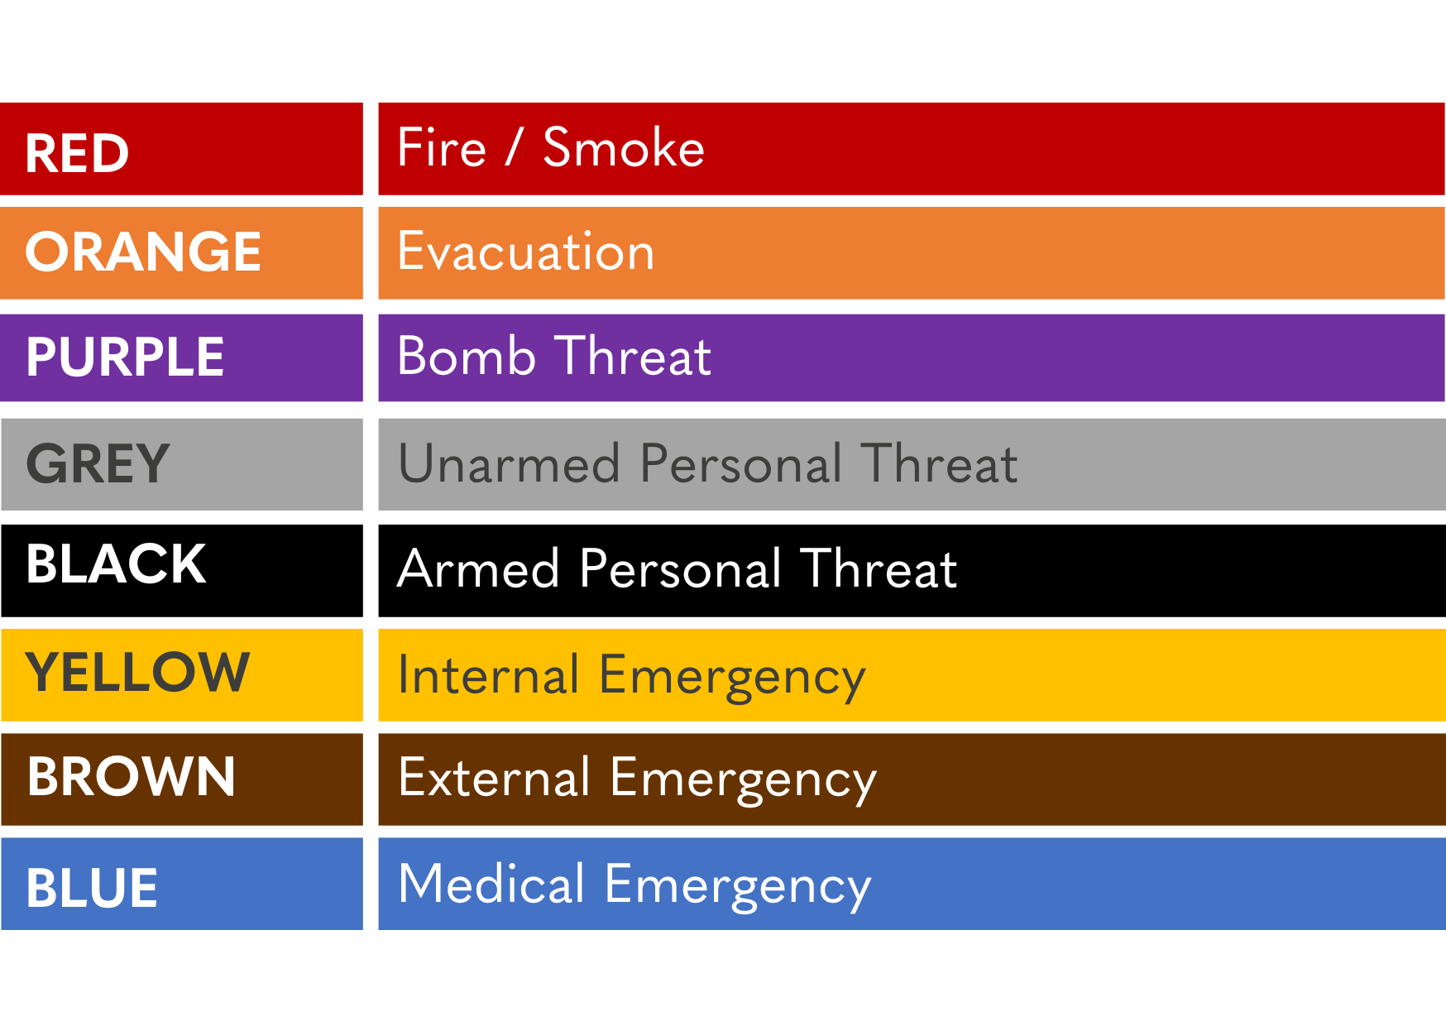
QEC Emergency Codes

Slide 17
If there are Signs of Smoke or Fire Standard Fire Procedure: RACE Principle
Remove - Anyone from immediate danger
Alert - Alert others in area
Alert employee(s) or others of the incident
Break the Manual Call Point (if alarm not sounding)
Report to your Area Warden – follow their instructions
Contain / Confine - Close doors and windows
Extinguish and/or Evacuate - If safe to do so, extinguish fire and evacuate

Slide 18
What you can expect from your placement
Be provided with a student handbook – useful information to support your placement
Buddying with an experienced QEC Clinician
Working within a dynamic learning environment
Opportunities to engage with QEC’s multi-disciplinary team
Observation of parenting education
Facilitated small group classes
Individual one-on-one with families
Participate in Playroom led sessions which may include “Toy Making”
Online Feedback survey

Slide 19
Checklist before placement
Students need to complete “The Basics of Infection Prevention and Control” eLearning module within 12 months prior to their placement date. Please send certificate through to learning@qec.org.au at least one week prior to commencing placement Please arrive at 8.30am on your first day, report to reception and a Clinical Educator will come to meet you. Students will need to complete a daily attestation via an online system called ‘Sine Pro’, at the start of each day of placement with QEC.

Slide 20
Feedback – making your experience and others the best it can be
QEC strive to provide a continuing, improving environment for families, employees, students and other stakeholders.
In order to do this we need your feedback.
Please complete the survey online using the link provided by
learning@qec.org.au after your placement.

Slide 21
Next Steps
On closing this final slide of the MCH Nurse Student Orientation please email learning@qec.org.au:
an acknowledgement confirming you have read this presentation
a copy of your certificate for “The Basics of Infection Prevention and Control.”
Thank you!
We look forward to welcoming you onsite at QEC

